Slide 1
CLOTHES
BY HERBER

Slide 2
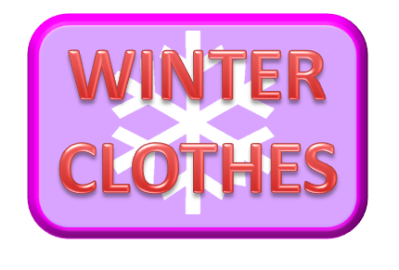
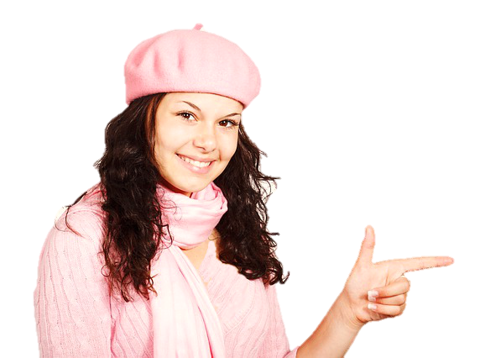
boots
coat
gloves
jumper
What’s this?
scarf
socks
hat
NEXT

Slide 3
boots
coat
gloves
jumper
What’s this?
scarf
socks
hat
NEXT

Slide 4
boots
coat
gloves
jumper
What are these?
scarf
socks
hat
NEXT

Slide 5
boots
coat
gloves
jumper
What’s this?
scarf
socks
hat
NEXT

Slide 6
boots
coat
gloves
jumper
What are these?
scarf
socks
hat
NEXT

Slide 7
boots
coat
gloves
jumper
What’s this?
scarf
socks
hat
NEXT

Slide 8
boots
coat
gloves
jumper
What’s this?
scarf
socks
hat
NEXT

Slide 9
WELL DONE!
CONGRATULATIONS!

Slide 10
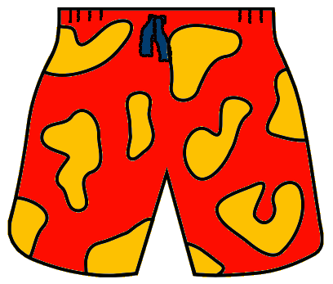
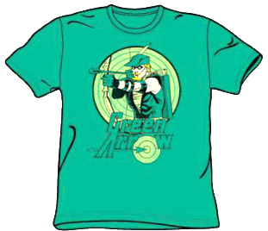
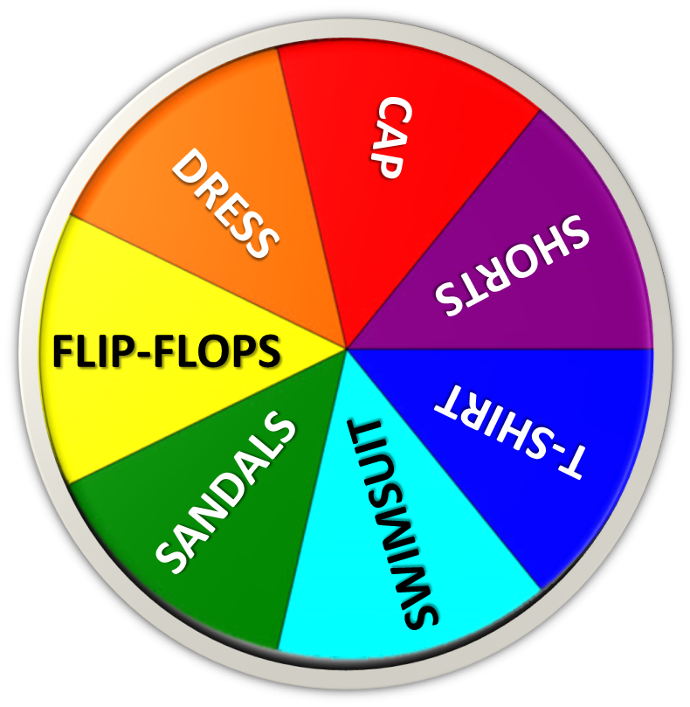
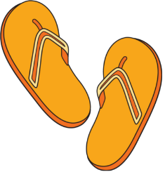
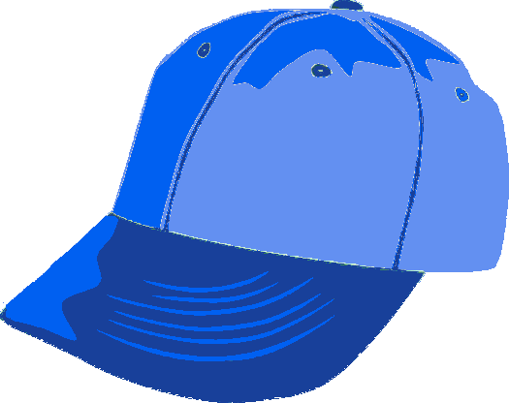
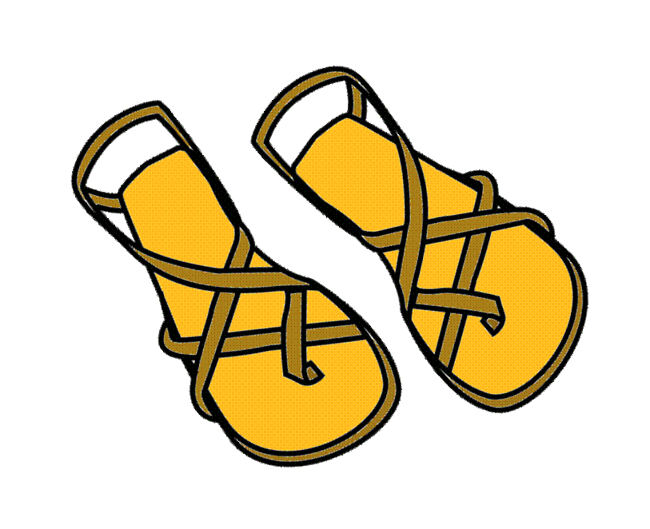
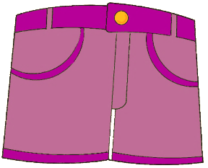
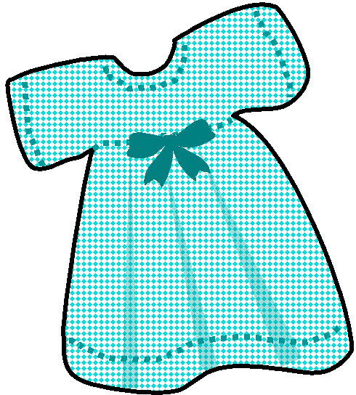
NEXT

Slide 11
NEXT

Slide 12
NEXT

Slide 13
NEXT

Slide 14
NEXT

Slide 15
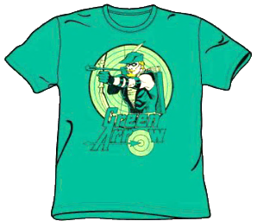
NEXT

Slide 16
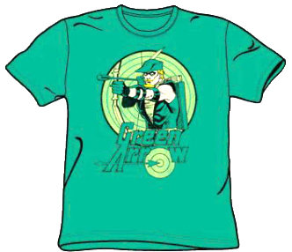
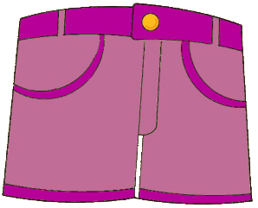
NEXT

Slide 17
WELL DONE!
CONGRATULATIONS!

