Slide 1
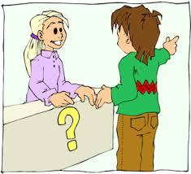
Can you tell me the way, please?

Slide 2
Watch these videos
https://www.youtube.com/watch?v=vB2HWzg-rjs
https://www.youtube.com/watch?v=-_YoeEY8FPM

Slide 3
Useful vocabulary
To ask about the direction
Can you tell me the way – moze da mi go pokazete patot
Excuse me, how do I get to …, please? – Izvinete kako da stignam do
Excuse me, where is the …? Izvinete kade e…

Slide 4
Giving directions
Go up/ down the street – odi nagore/ nadole po ulicata
Go straight on – odi pravo

Slide 5
Turn left at – svrti levo na
Turn right – svrti desno

Slide 6
It’s opposite – se naogja sproti
It’s on your left / right – se naogja od tvojata leva/ desna strana

